Slide 1
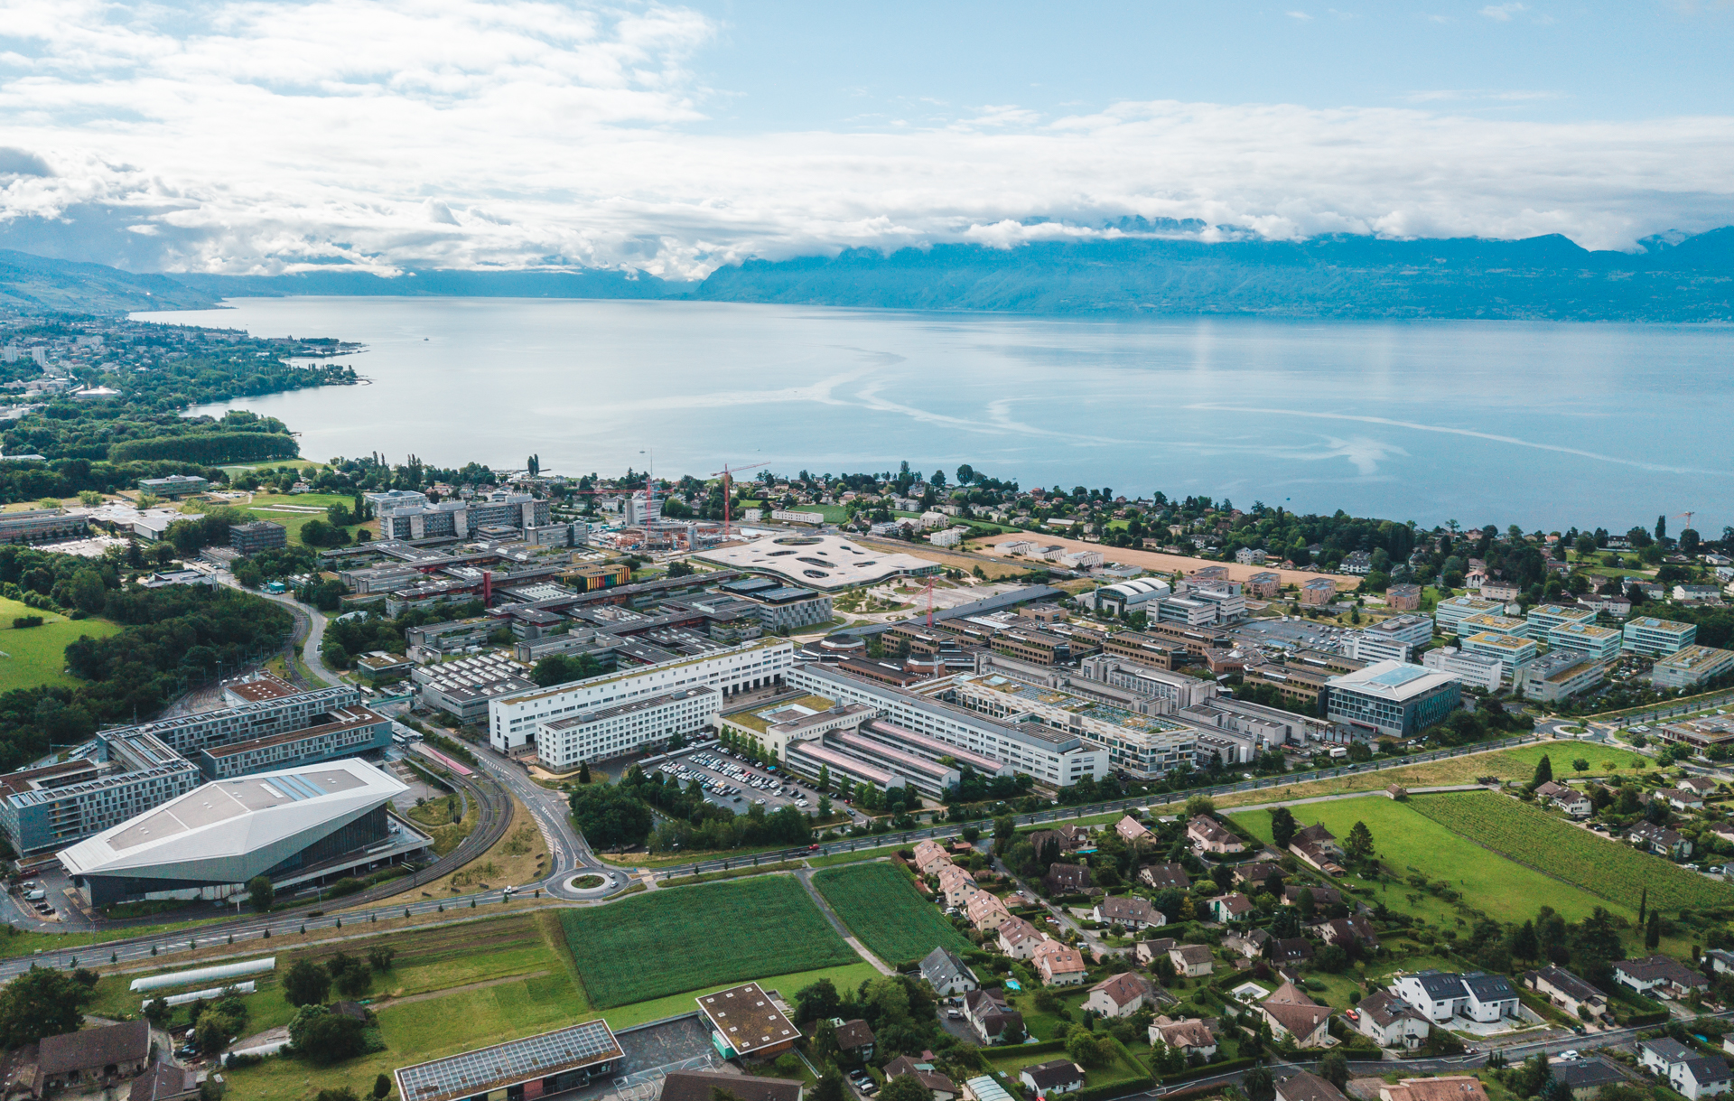
Welcome
Carey Sargent
2 September 2025

Slide 2
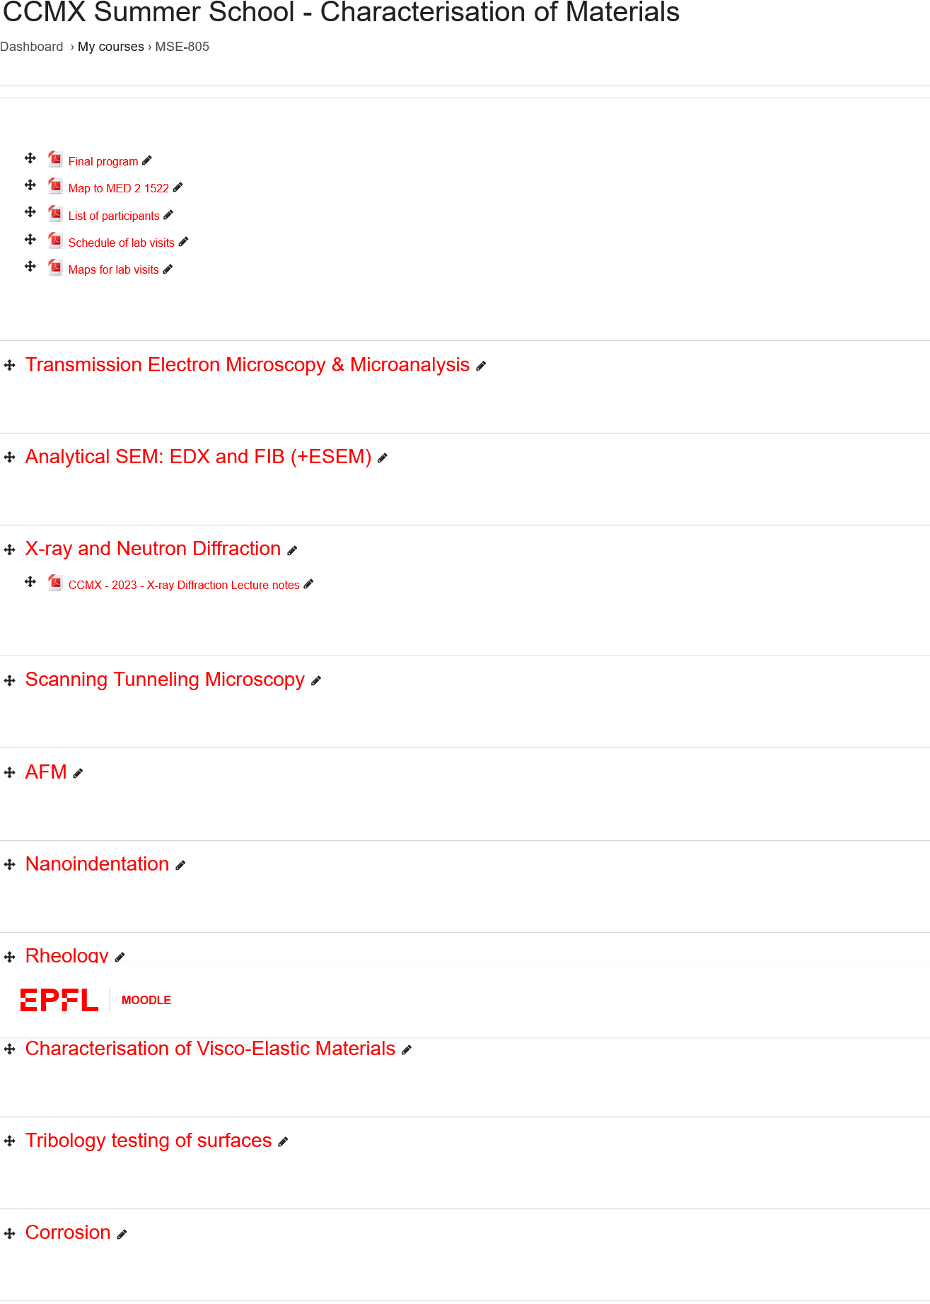
Moodle
https://go.epfl.ch/charmat25

Slide 3
Program

Slide 4
Lab visits
Group 1: Vikraman Haribaskar, Maryam Heidari, Ruth Kasavo, Rémi Martinie, Prajkta Nehete
Group 2: Simone Cigagna, Greta Cocchi, Ding Ren, Shixuan Shan, Ziwei Zhou
Group 3: Gizem Beliktay, Yuki Hayashi, Sarah Marroquin, Buse Tatli
https://plan.epfl.ch/

Slide 5
ECTS Credits
PhD students may validate this course for one ECTS credit. To do this, they must:
  Be present at lectures and lab sessions
  Pass the final, multiple-choice question exam
For doctoral programs outside of EPFL:
  You will need to apply for course credit from your doctoral program

Slide 6
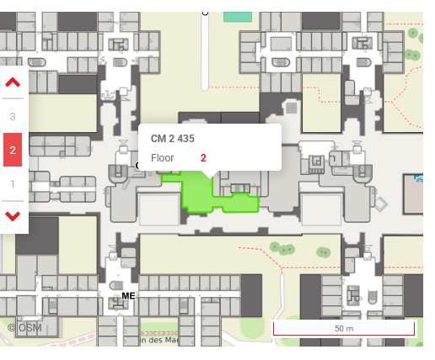
Lunch - Foodlab

Slide 7
Introductions
Two truths and a lie

Slide 8
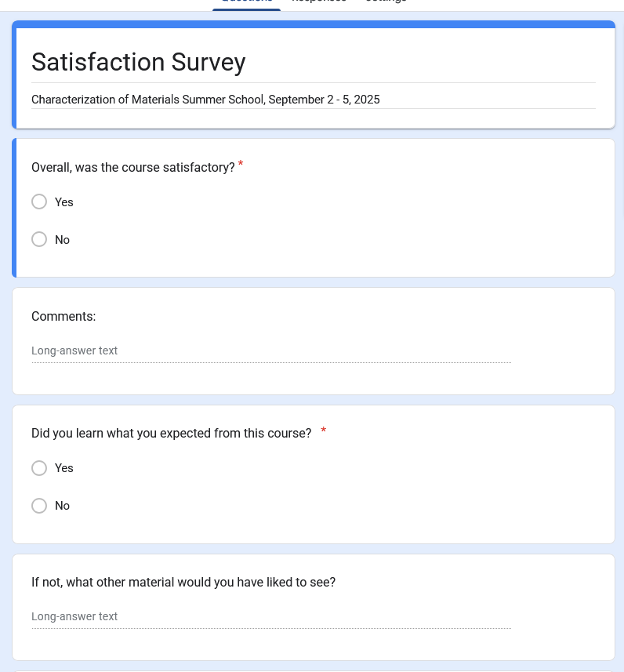
Survey
Survey link

